Slide 1
MATLAB for image processing Session 2: Matrices and image processing

Slide 2

Course structure
Session 1
Introduction to MATLAB
Data types
Conditional statements and loops
Session 3
Advanced data structures
Advanced image reading (Bioformats)
Object-oriented programming
Session 2
Matrix operations
Figures and plotting
Image processing
Session 4
Designing a user interface
Requests? Let me know!
stephen.cross@bristol.ac.uk

Slide 3
Matrix operations
Notes:
Convert this into 2 spider diagrams if there’s time

Slide 4
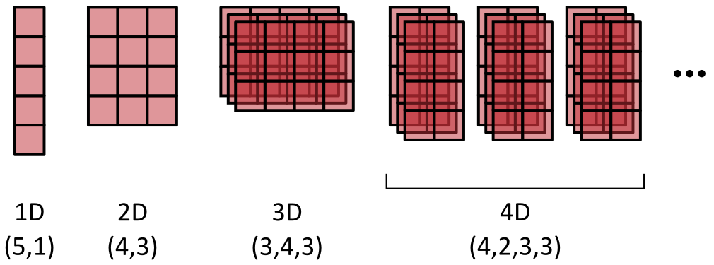
Introduction to matrices
So far we’ve only looked at variables holding a single value
Matrices hold multiple numeric values in an n-dimensional grid
MATLAB is specifically optimised for calculations on these
Have a minimum of 2 dimensions (XY)
XY dimensions always specified first in the order (row, column)

Slide 5
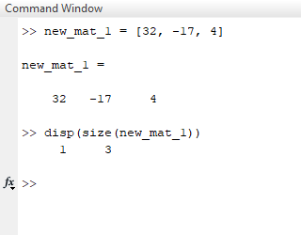
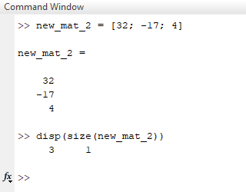
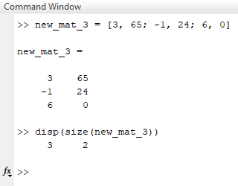
Creating matrices
Creating a 2D matrix from known values
Surround values with square brackets
Comma-separate items on the same row
Semicolon-separate rows
A single row
A single column
A true 2D matrix

Slide 6
Combining matrices
Matrices can be joined along existing or new axes
Used to create higher dimensionalities than 2D
Using concatenation function
Create separate matrices, then join using cat function
First argument of cat specifies axis to concatenate along
By indexing
Create separate matrices, then merge one into the other
Not as simple to extend existing dimensions (cat is better)
We’ll look into indexing in more detail later on

Slide 7
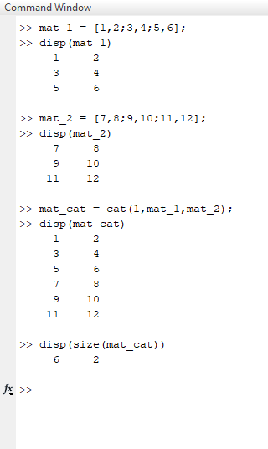
Combining matrices
Matrices can be joined along existing or new axes
Used to create higher dimensionalities than 2D
Using concatenation function
Create separate matrices, then join using cat function
First argument of cat specifies axis to concatenate along
By indexing
Create separate matrices, then merge one into the other
Not as simple to extend existing dimensions (cat is better)
We’ll look into indexing in more detail later on

Slide 8
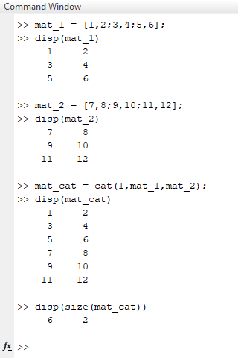
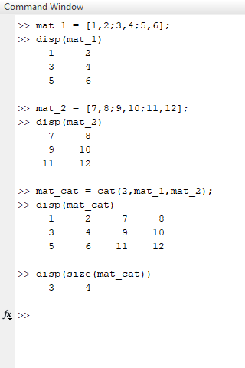
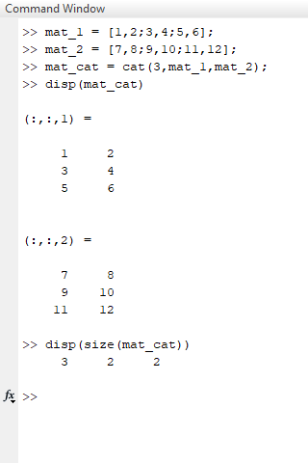
Combining matrices
Joining vertically
Joining horizontally
Joining along new axis

Slide 9
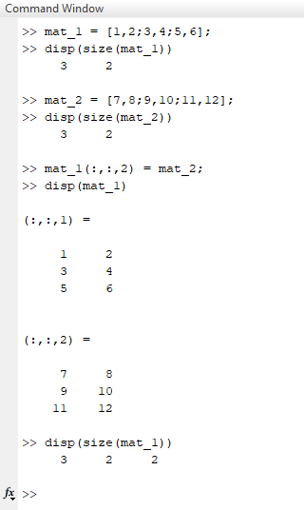
Combining matrices
Matrices can be joined along existing or new axes
Used to create higher dimensionalities than 2D
Using concatenation function
Create separate matrices, then join using cat function
First argument of cat specifies axis to concatenate along
By indexing
Create separate matrices, then merge one into the other
Not as simple to extend existing dimensions (cat is better)
We’ll look into indexing in more detail later on

Slide 10
Creating matrices
Initialising an empty matrix
Matrices can be re-sized, but this is SLOW

Slide 11
Creating matrices
[Have them do an exercise]

Slide 12
Accessing matrix data
Access values in a matrix using coordinates

Slide 13
Introduction to matrices
Demo creating a small matrix
Could use rand(3)
Dimension order
Indexing
Accessing a single value
Accessing a range of values

Slide 14
Introduction to matrices
Matrix operations
Start by adding a single value to a matrix
Add two matrices together
Talk about the element-wise dot (e.g. .*)

Slide 15
Initialising matrices
Why and how?
Demo of creating a matrix
Non-initialised
Initialised

Slide 16
Optimising code
Tic toc
Demo
Profiler
Demo

Slide 17
Visualising data
Notes:
Convert this into 2 spider diagrams if there’s time

Slide 18
Image loading
Figures and plotting
Generate a 1D trace, then plot this
Functions
hold
gca

Slide 19
Image processing
Notes:
Convert this into 2 spider diagrams if there’s time

Slide 20
Image loading
Using standard libraries
imread
Oh look, they’re matrices
Multidimensionality

Slide 21
Visualising images
image
imagesc
imshow

Slide 22
Image processing
Filters
Median
Gaussian
Thresholding
Otsu method

Slide 23
Saving images
imwrite

